Slide 1
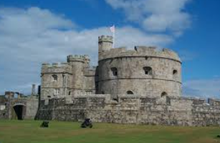
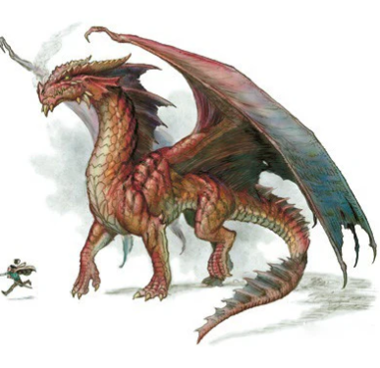
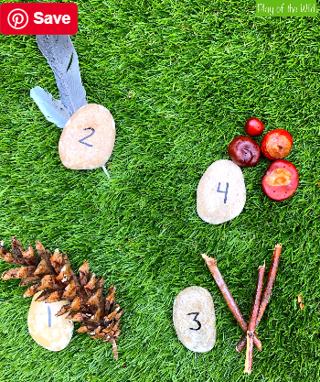
Starfish Reception Homework
Castles, Knights and Dragons!
Summer Term 1st half 2026
Over this half term you need to complete at least 2 activities.
Please hand in, or post on Class Dojo, by the following dates:
Thursday 30th April, the second by Thursday 14th May.
Reading Please hear your child read daily and watch any Read, Write, Inc videos posted. Daily practice will have a big impact on your child’s fluency and confidence.
DT – make a model castle out of recycled materials or whatever you choose. Include typical features of a castle e.g. moat, drawbridge, arrow slits, turrets, battlements maybe even some occupants!
Art – Draw or paint a picture of a dragon and bring into school to show us. Can you think of any words to describe a dragon and write them around your picture?
Maths – Go for a walk and make a number collage using items from nature and the outdoors. Use numbers 1-10 or further if you can!
Label your items with the correct number.

