Slide 1
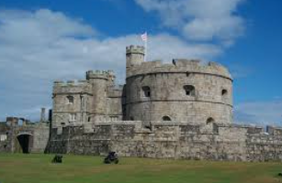
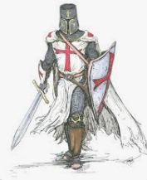
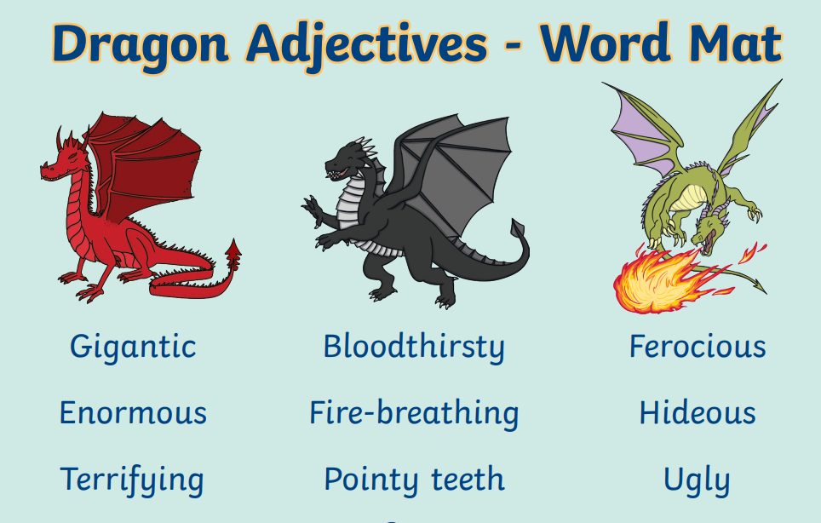
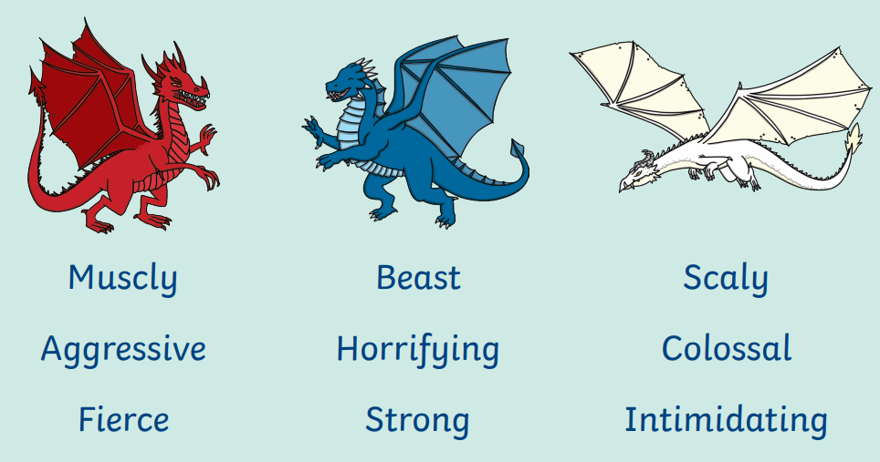
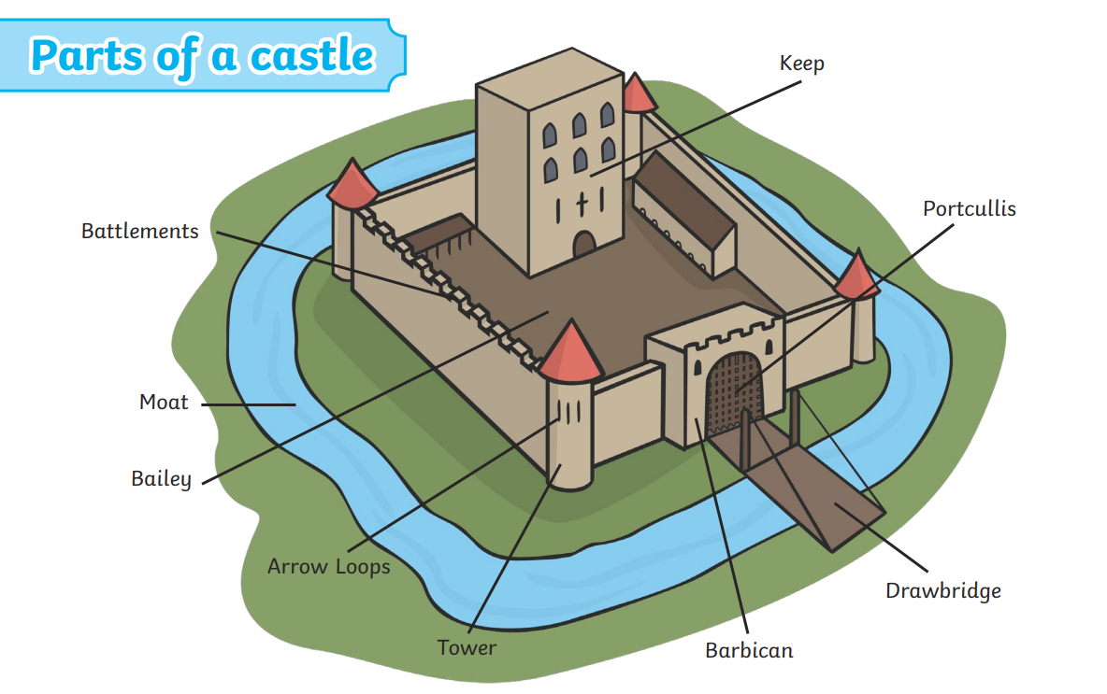
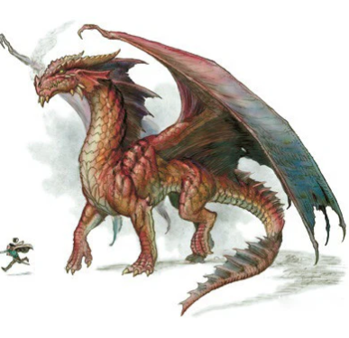
Quiz
1. What is a castle?
2. Name at least 4 castles in Cornwall.
3. Why were castles built near the sea in places like Falmouth?
4. What is special about Tintagel Castle?
5. What did knights wear to protect themselves?
6. What famous knight defeated a dragon according to legend?
7. What surrounds some castles and why?
8. What would you be able to see from the top of Pendennis Castle?
9. Who ordered the building of Pendennis and St Mawes castles?
10. Find 3 facts about Pendennis Castle.
Starfish Year 1 and 2 Homework
Castles, Knights and Dragons!
Summer Term 1st half 2026
Over this half term you need to complete at least 2 activities, including my Maths. You can choose any homeworks from this sheet or the previous half term.
Please hand in, or post on Class Dojo, by the following dates:
Thursday 30th April, the second by Thursday 14th May.
Reading Please hear your child read daily.
Spellings (Year 2 who have finished the phonics programme only) New Year 2 spelling lists have been posted on Dojo and the children will be bringing home paper copies. Please practise with your child.
My Maths –This is a compulsory homework. All 3 tasks set count as one homework.
Literacy – We have looked at lots of poems in school. Now it’s your turn! Write a poem about a dragon – start by mind mapping lots of different adjectives and powerful verbs to describe dragons. Your final poem could be an acrostic, shape poem, rhyming or whatever you like. Decorate it and practise reading it aloud at home so you can share with the class if you like.
DT – make a model castle out of recycled materials or whatever you choose. Include typical features of a castle e.g. moat, drawbridge, arrow slits, turrets, battlements maybe even some occupants! Label the features clearly.
Quiz – Answer the questions in the quiz in your best
Handwriting, remembering capital letters and full stops.

