Slide 1





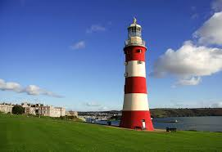
https://www.youtube.com/watch?v=OaW_4MWSE6I
Growing our body, our mind and our spirit

Slide 2
Our Vision
Nurturing to Flourish in Our World.
Our special bible story
“The Good Samaritan”
Q1. What is a vision?
Q2. What is the message behind our vision statement?
Q3. What are my favourite words in our vision statement?

Slide 3
Our Vision
Nurturing to Flourish in Our World.
Our special bible story
“The Good Samaritan”
Q1. What is a vision? It describes what a school should look and feel like.
Q2. What is the message behind our vision statement? Looking after each other so that everyone can be the best they can be.
Q3. What are my favourite words in our vision statement?

Slide 5


Slide 6




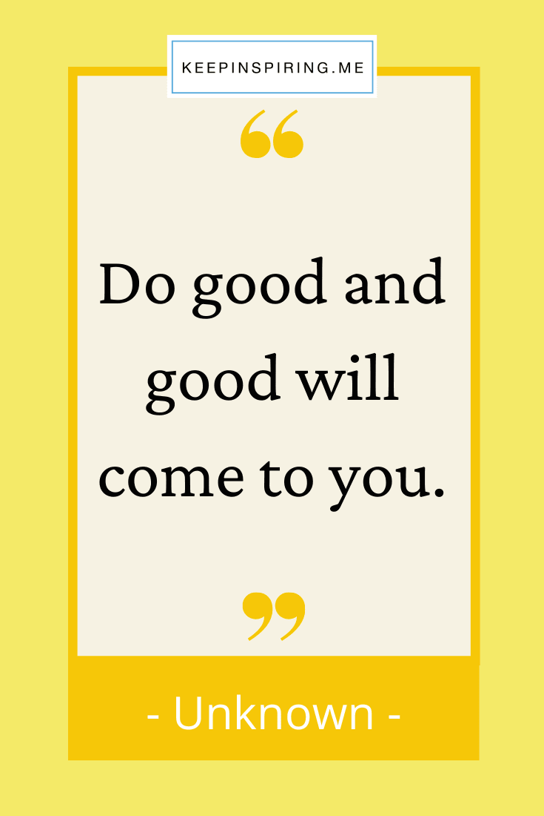
Our behaviour motto:

Slide 7


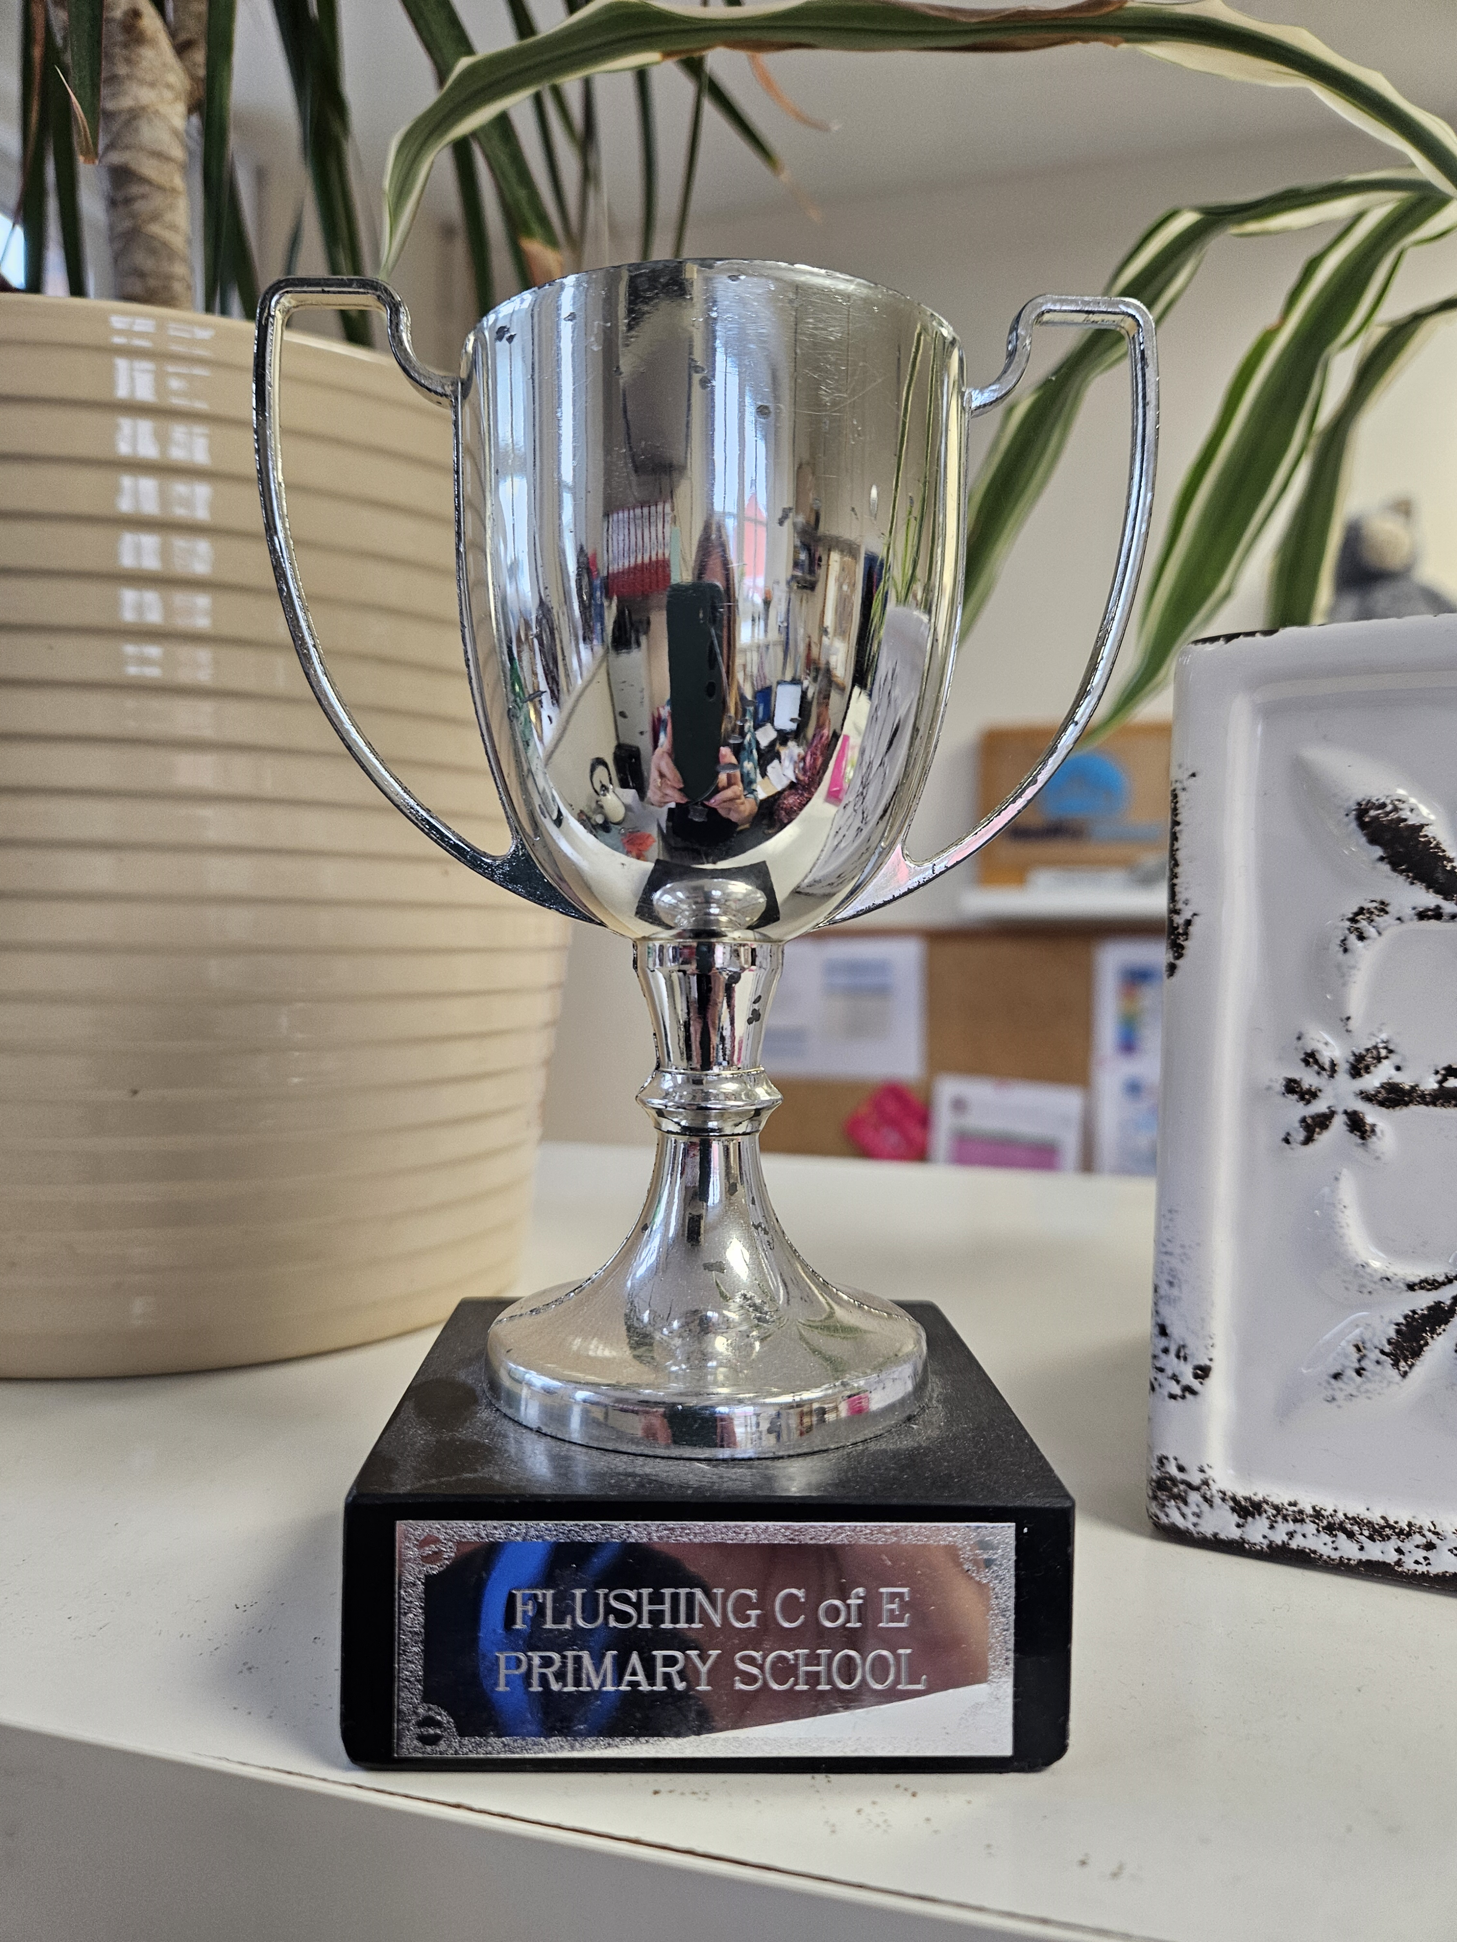
Our attendance motto:
We are going to be celebrating good attendance in lots of ways

Slide 8



Our punctuality motto:
On time, on target.
We are going to be celebrating good punctuality too.

Slide 9

It’s Good To Be Good
Curriculum

Slide 10
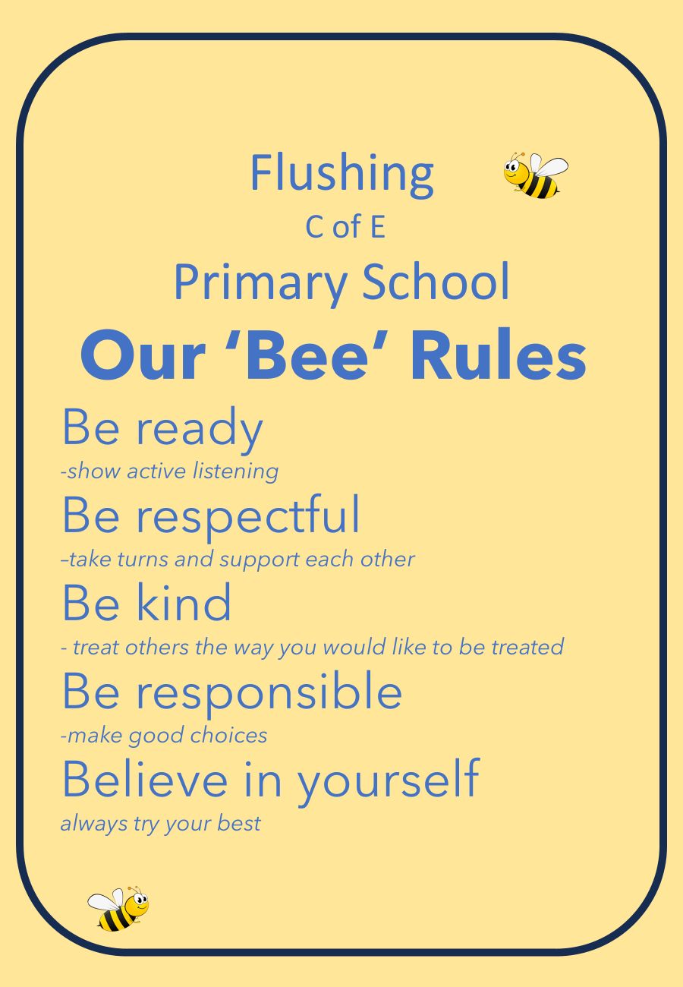
Our school rules
We love to see EXPECTED behaviour
Follow, God, follow good

Slide 11
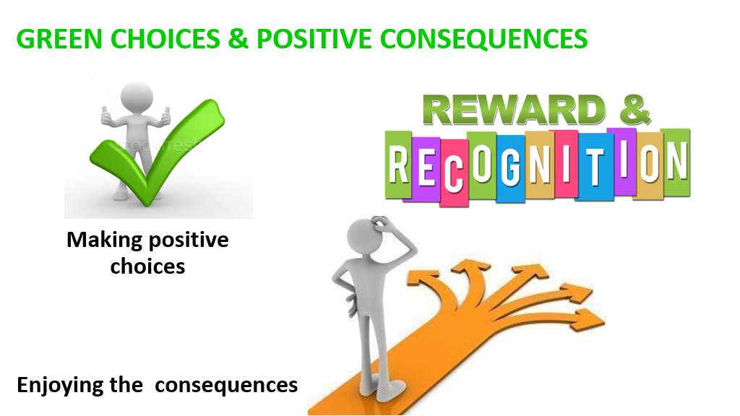
We love to see EXPECTED behaviour

Slide 12

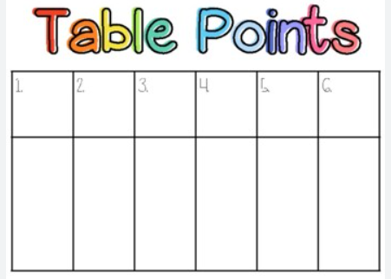
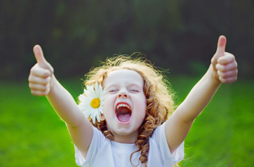




We love to see EXPECTED behaviour
daily

Slide 13
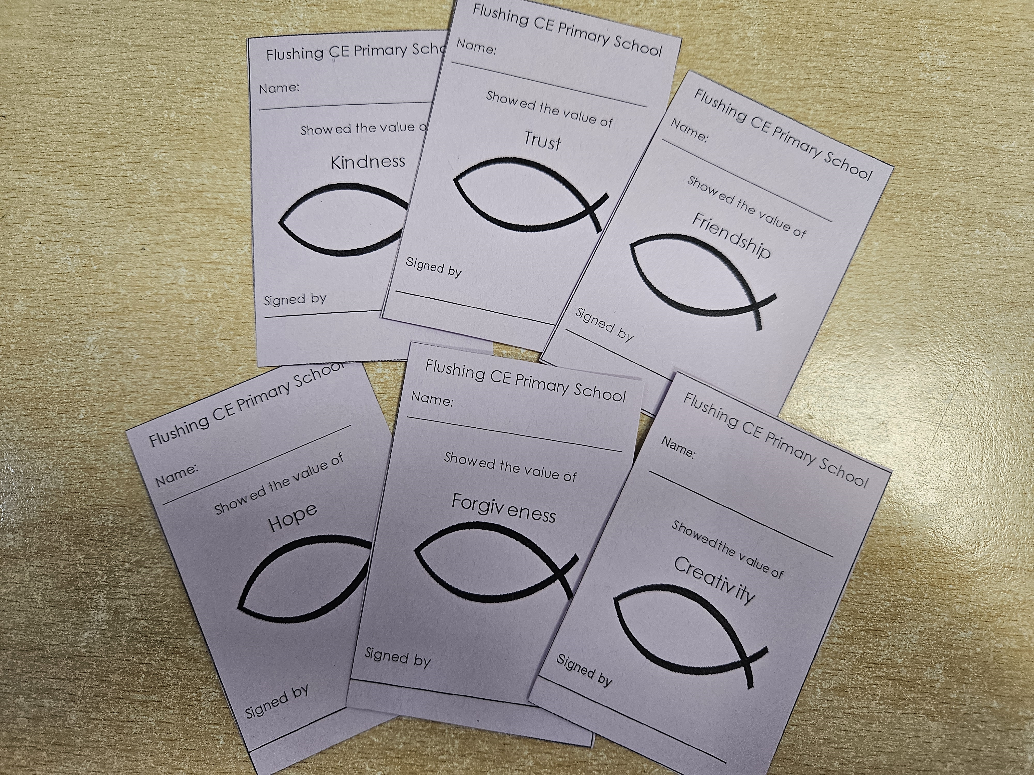

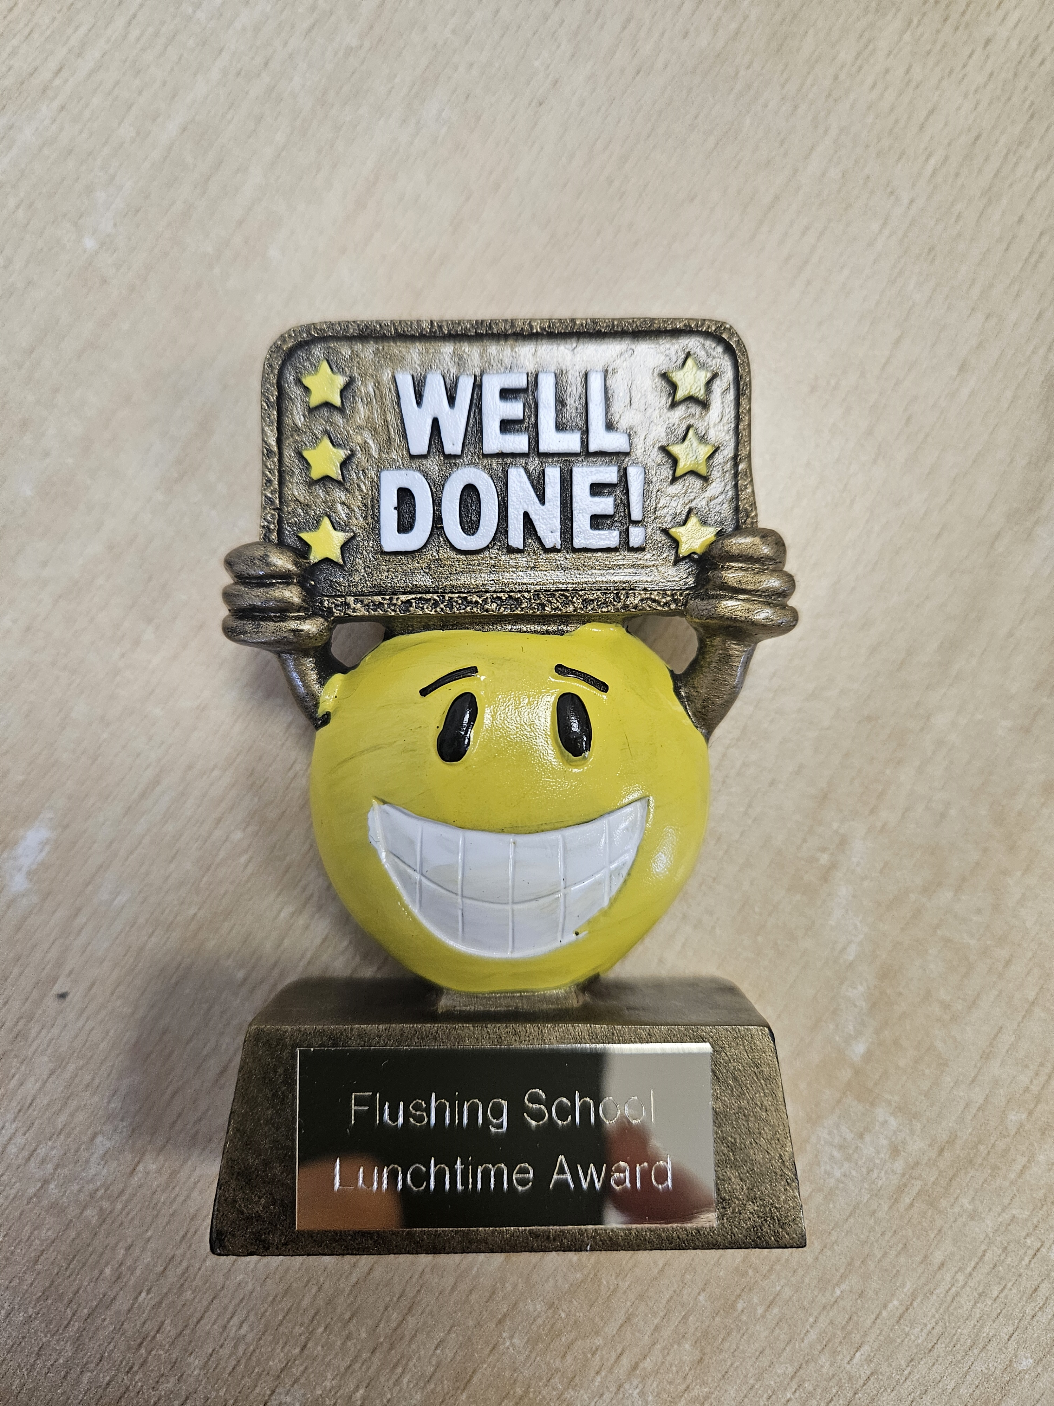
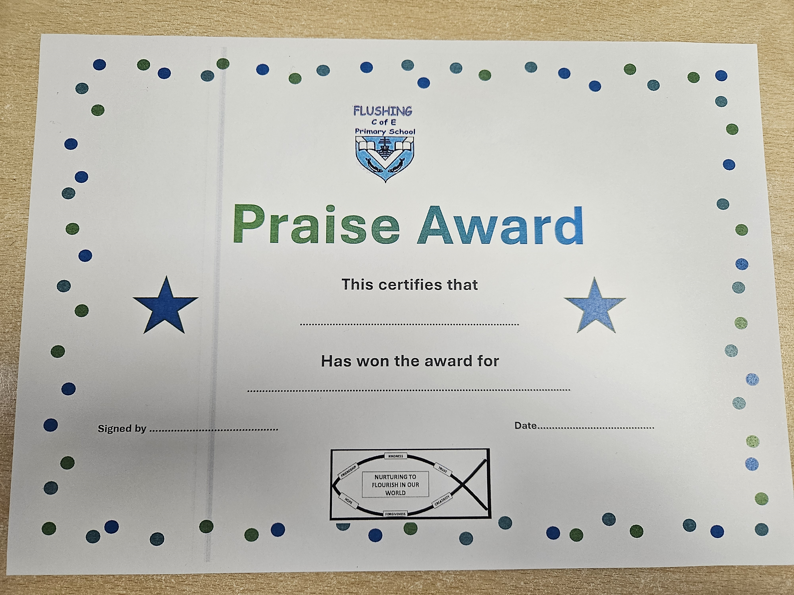
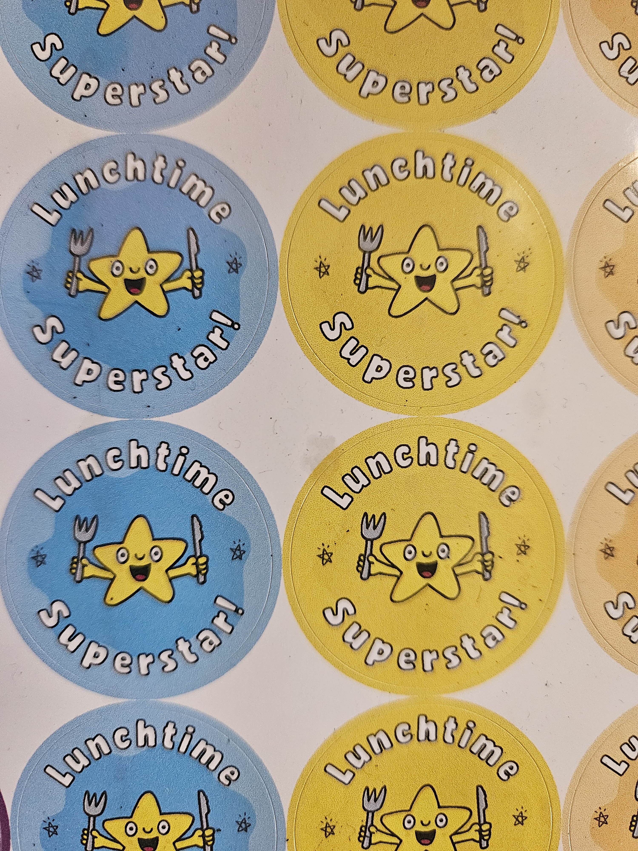
We love to see EXPECTED behaviour
weekly

Slide 14

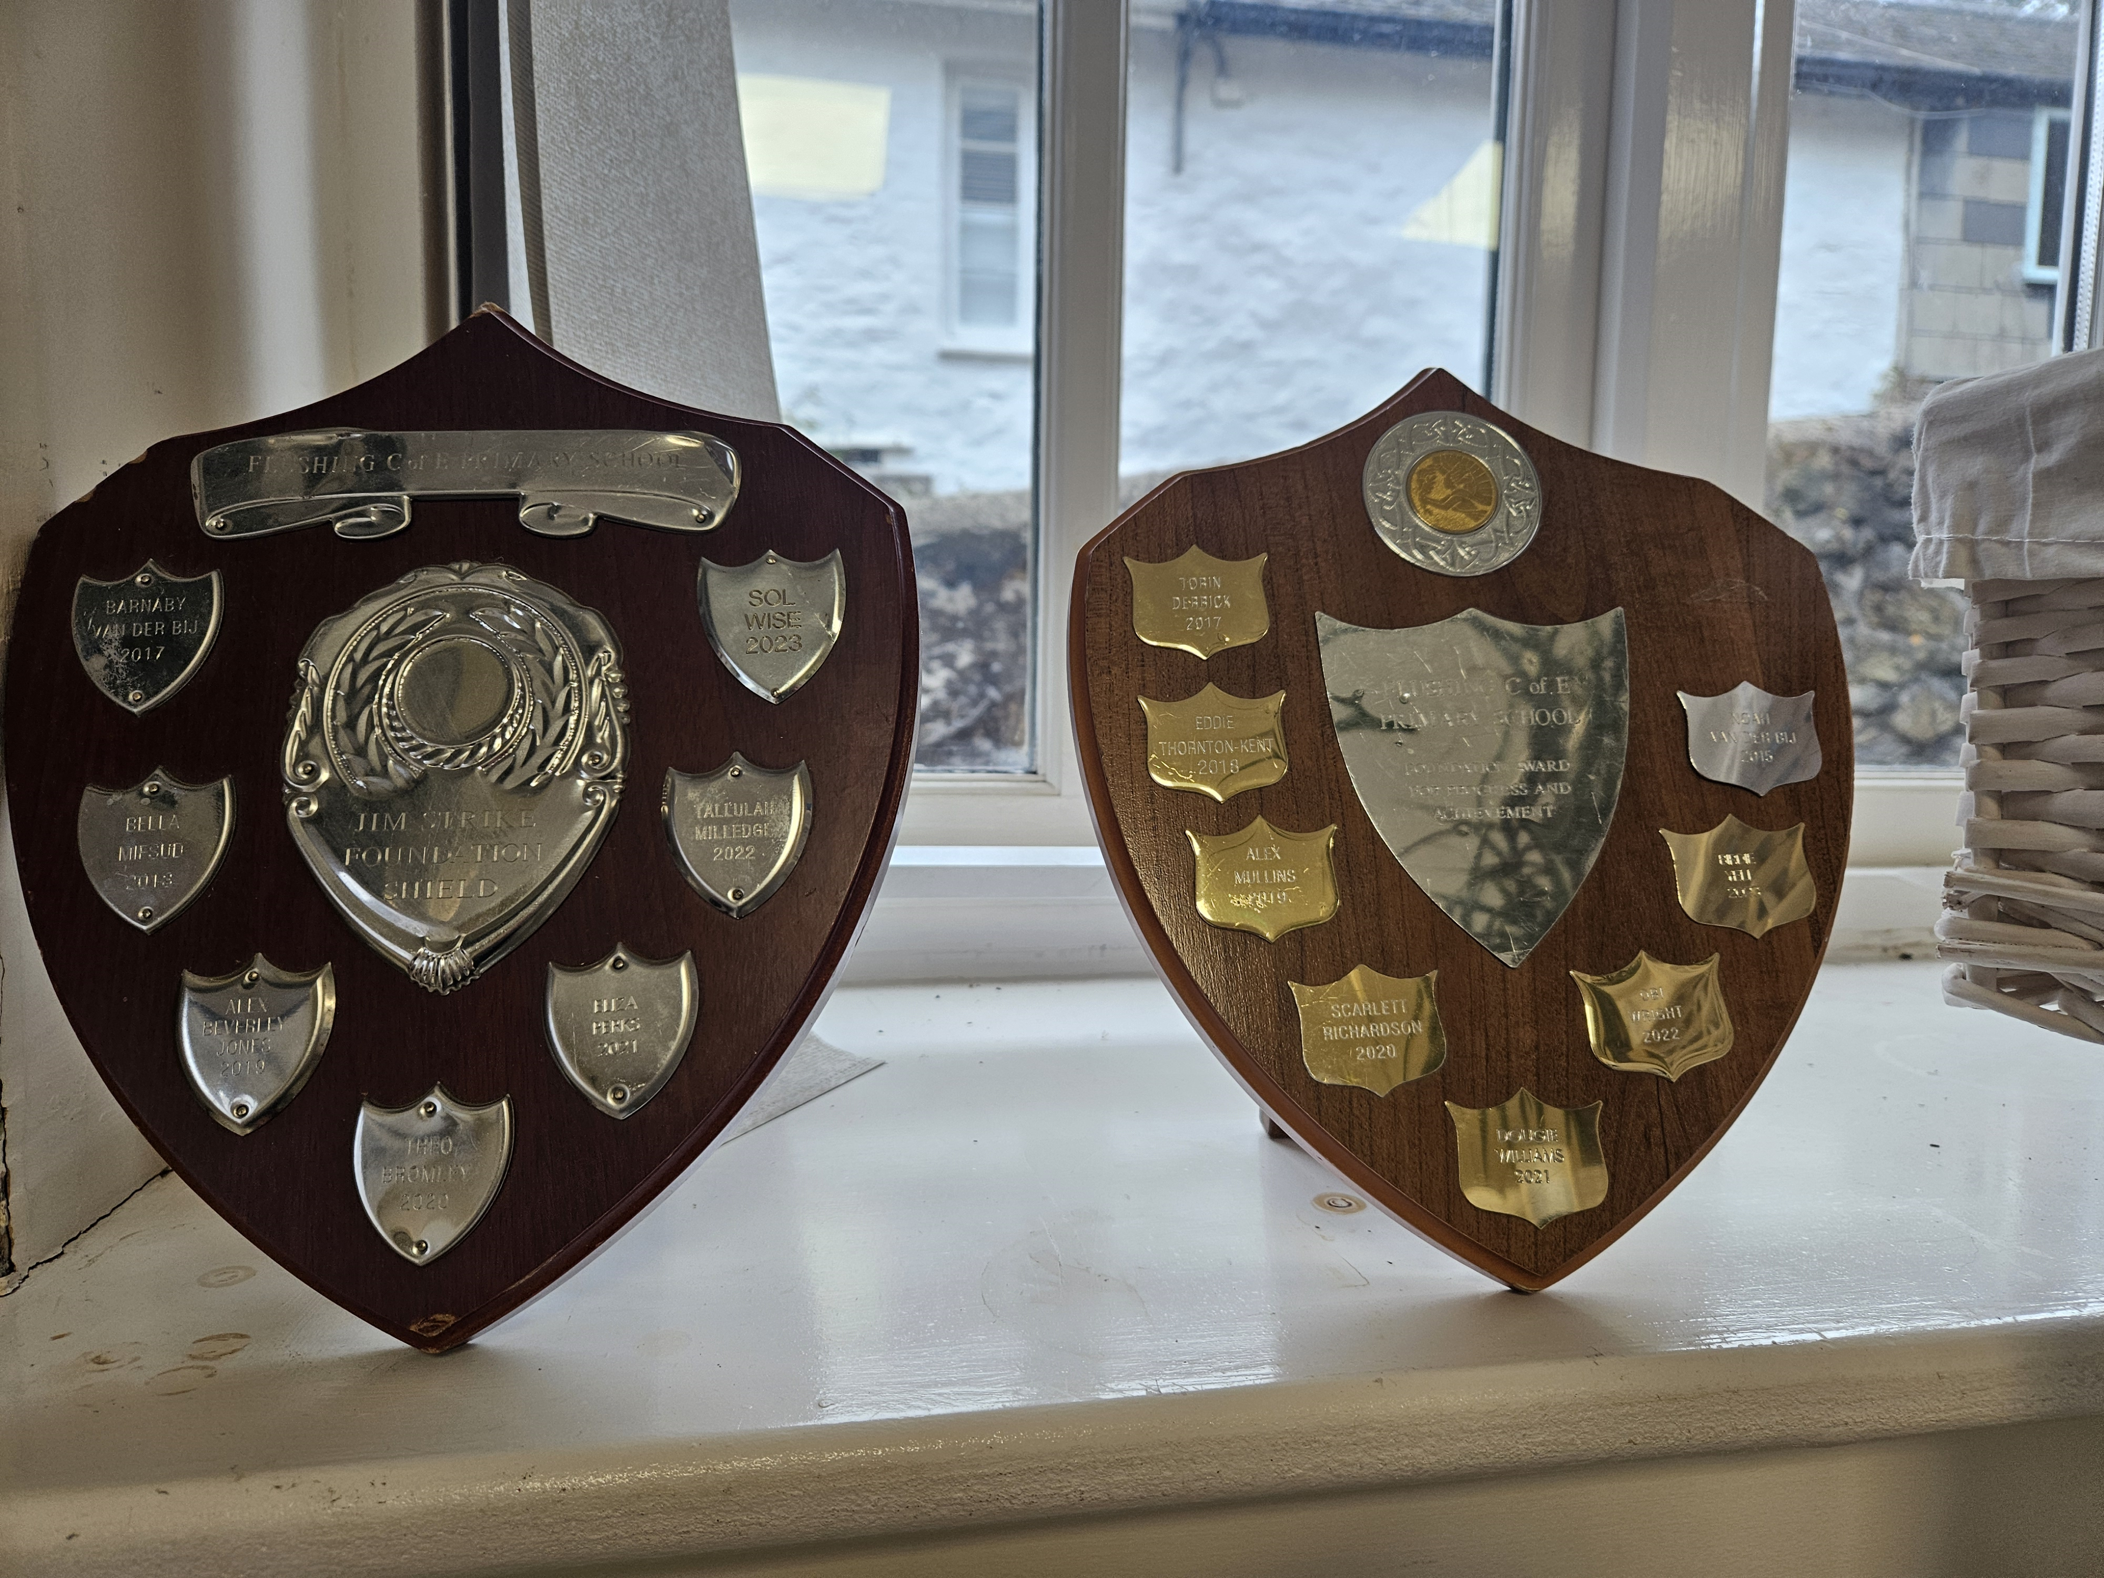
Once a year!
We love to see EXPECTED behaviour

Slide 15
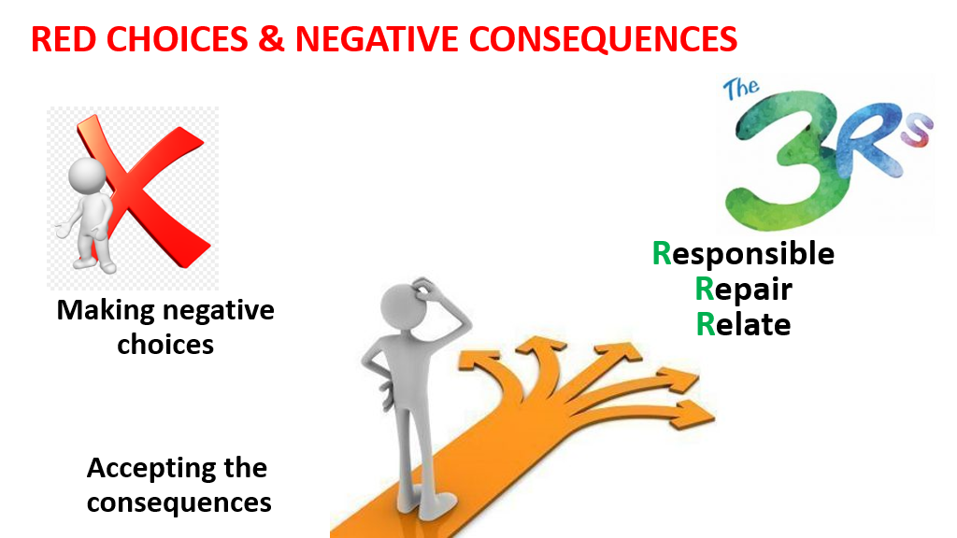
We need to talk about UNEXPECTED behaviour

Slide 16
YELLOW BEHAVIOURS EXAMPLES | Calling out Distracting others Making noise in class Not looking after property, e.g. doodling on exercise books Repeated leaving seats without permission Time wasting Not following instructions Running in the corridor Pushing in in the line Talking in assembly Rudeness to others Interrupting Children being inside when they should be outside Shouting in the dinner hall | Clear verbal warning Time given to change behaviour

Slide 17
AMBER BEHAVIOURS EXAMPLES | A second warning for one of the yellow behaviours Constantly calling out Continually distracting others Refusing to follow instructions Deliberate rudeness, e.g. answering back Not attempting learning task Covering up the truth Unkind words and actions Swearing (overheard by an adult) | Miss 5 minutes of breaktime spent in reflection time with an adult to discuss what happened and reflect on future behaviour. The staff will write down what has happened and tell parents at the end of the day or through a phone call/dojo message

Slide 18
SERIOUS RED BEHAVIOURS EXAMPLES | Hurting others with our bodies, our actions or by words. Threatening others Bullying Damaging things Stealing things Stopping the learning for others. | Complete appropriate reflection sheet ‘Make It Right’ Tidy up any mess / damage or wrong doing Miss 2/3 breaks. Mrs Power involved The staff will write down what has happened and tell parents at the end of the day or through a phone call/dojo message Often, parents will be requested to come into school to discuss red behaviour

Slide 19
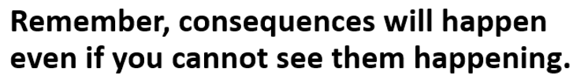

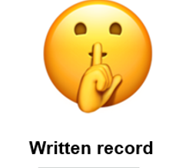
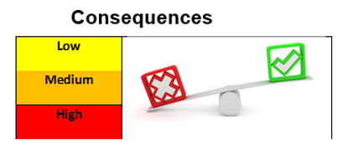
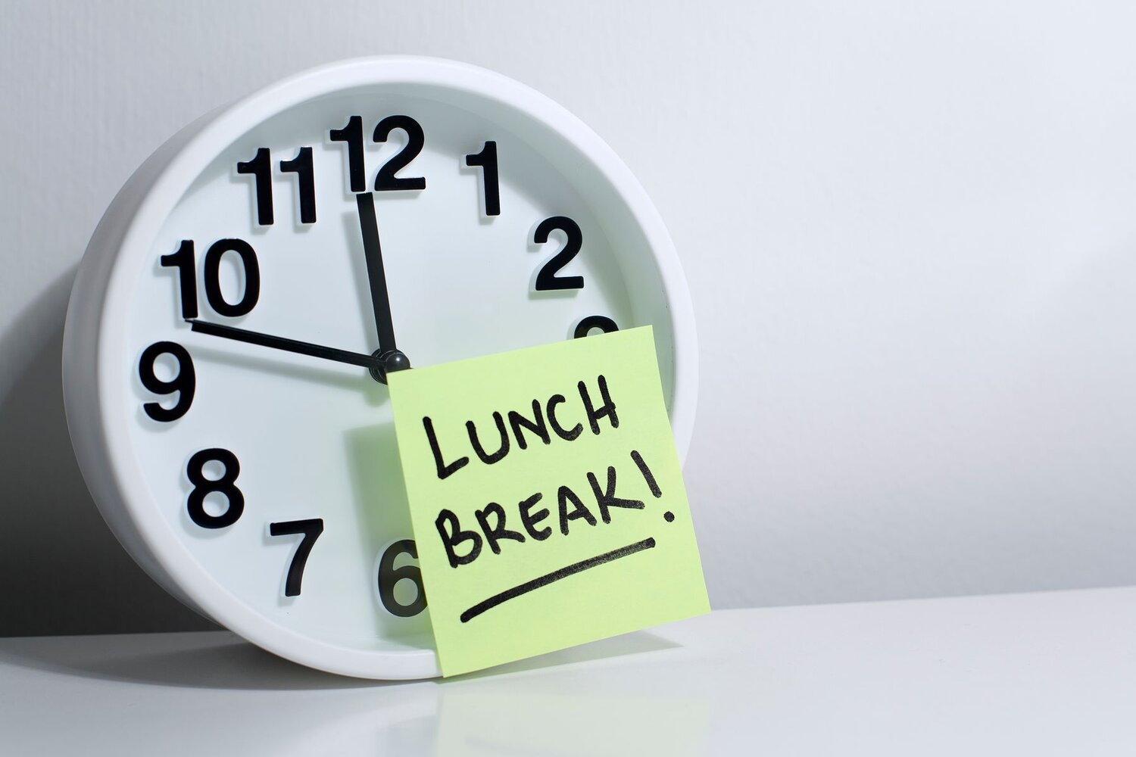

Slide 20

A consequence is a fair reaction to behaviour that
has not been agreed or expected
“Low” behaviour
“Low” consequence

Slide 21



If we make negative choices and hurt or harm someone, then we want to…..

Slide 22
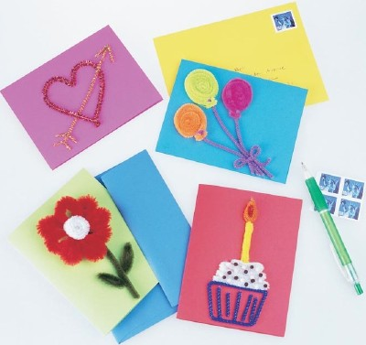



Make a card or picture
We will say sorry, or show sorry (apologise)
Give a simple gift
Behave differently

Slide 23


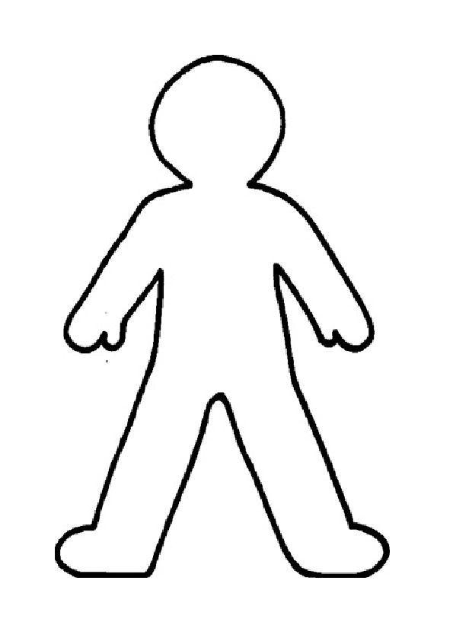

Making It Right
Give & receive forgiveness (hold no grudge)
Forgiveness
GIVE
RECEIVE
The person who has been hurt
The person who has done the hurt
We will hear and share what both people have to say

Slide 24
If there were any bits that you weren’t really sure about, then your class teacher can talk to you about it.
?

Slide 25

HT Over and Above
What can you do to earn it?
Over & above behaviour and attitude
Excellent or exceptional work
Excellent or exceptional effort with your work (stickability)

Slide 26
On time, on target.

Slide 27


It’s good to be good.
We pray for God’s (God/good) presence in our school all through this year

Slide 28
https://www.youtube.com/watch?v=OaW_4MWSE6I
Growing our body, our mind and our spirit

